Slide 1
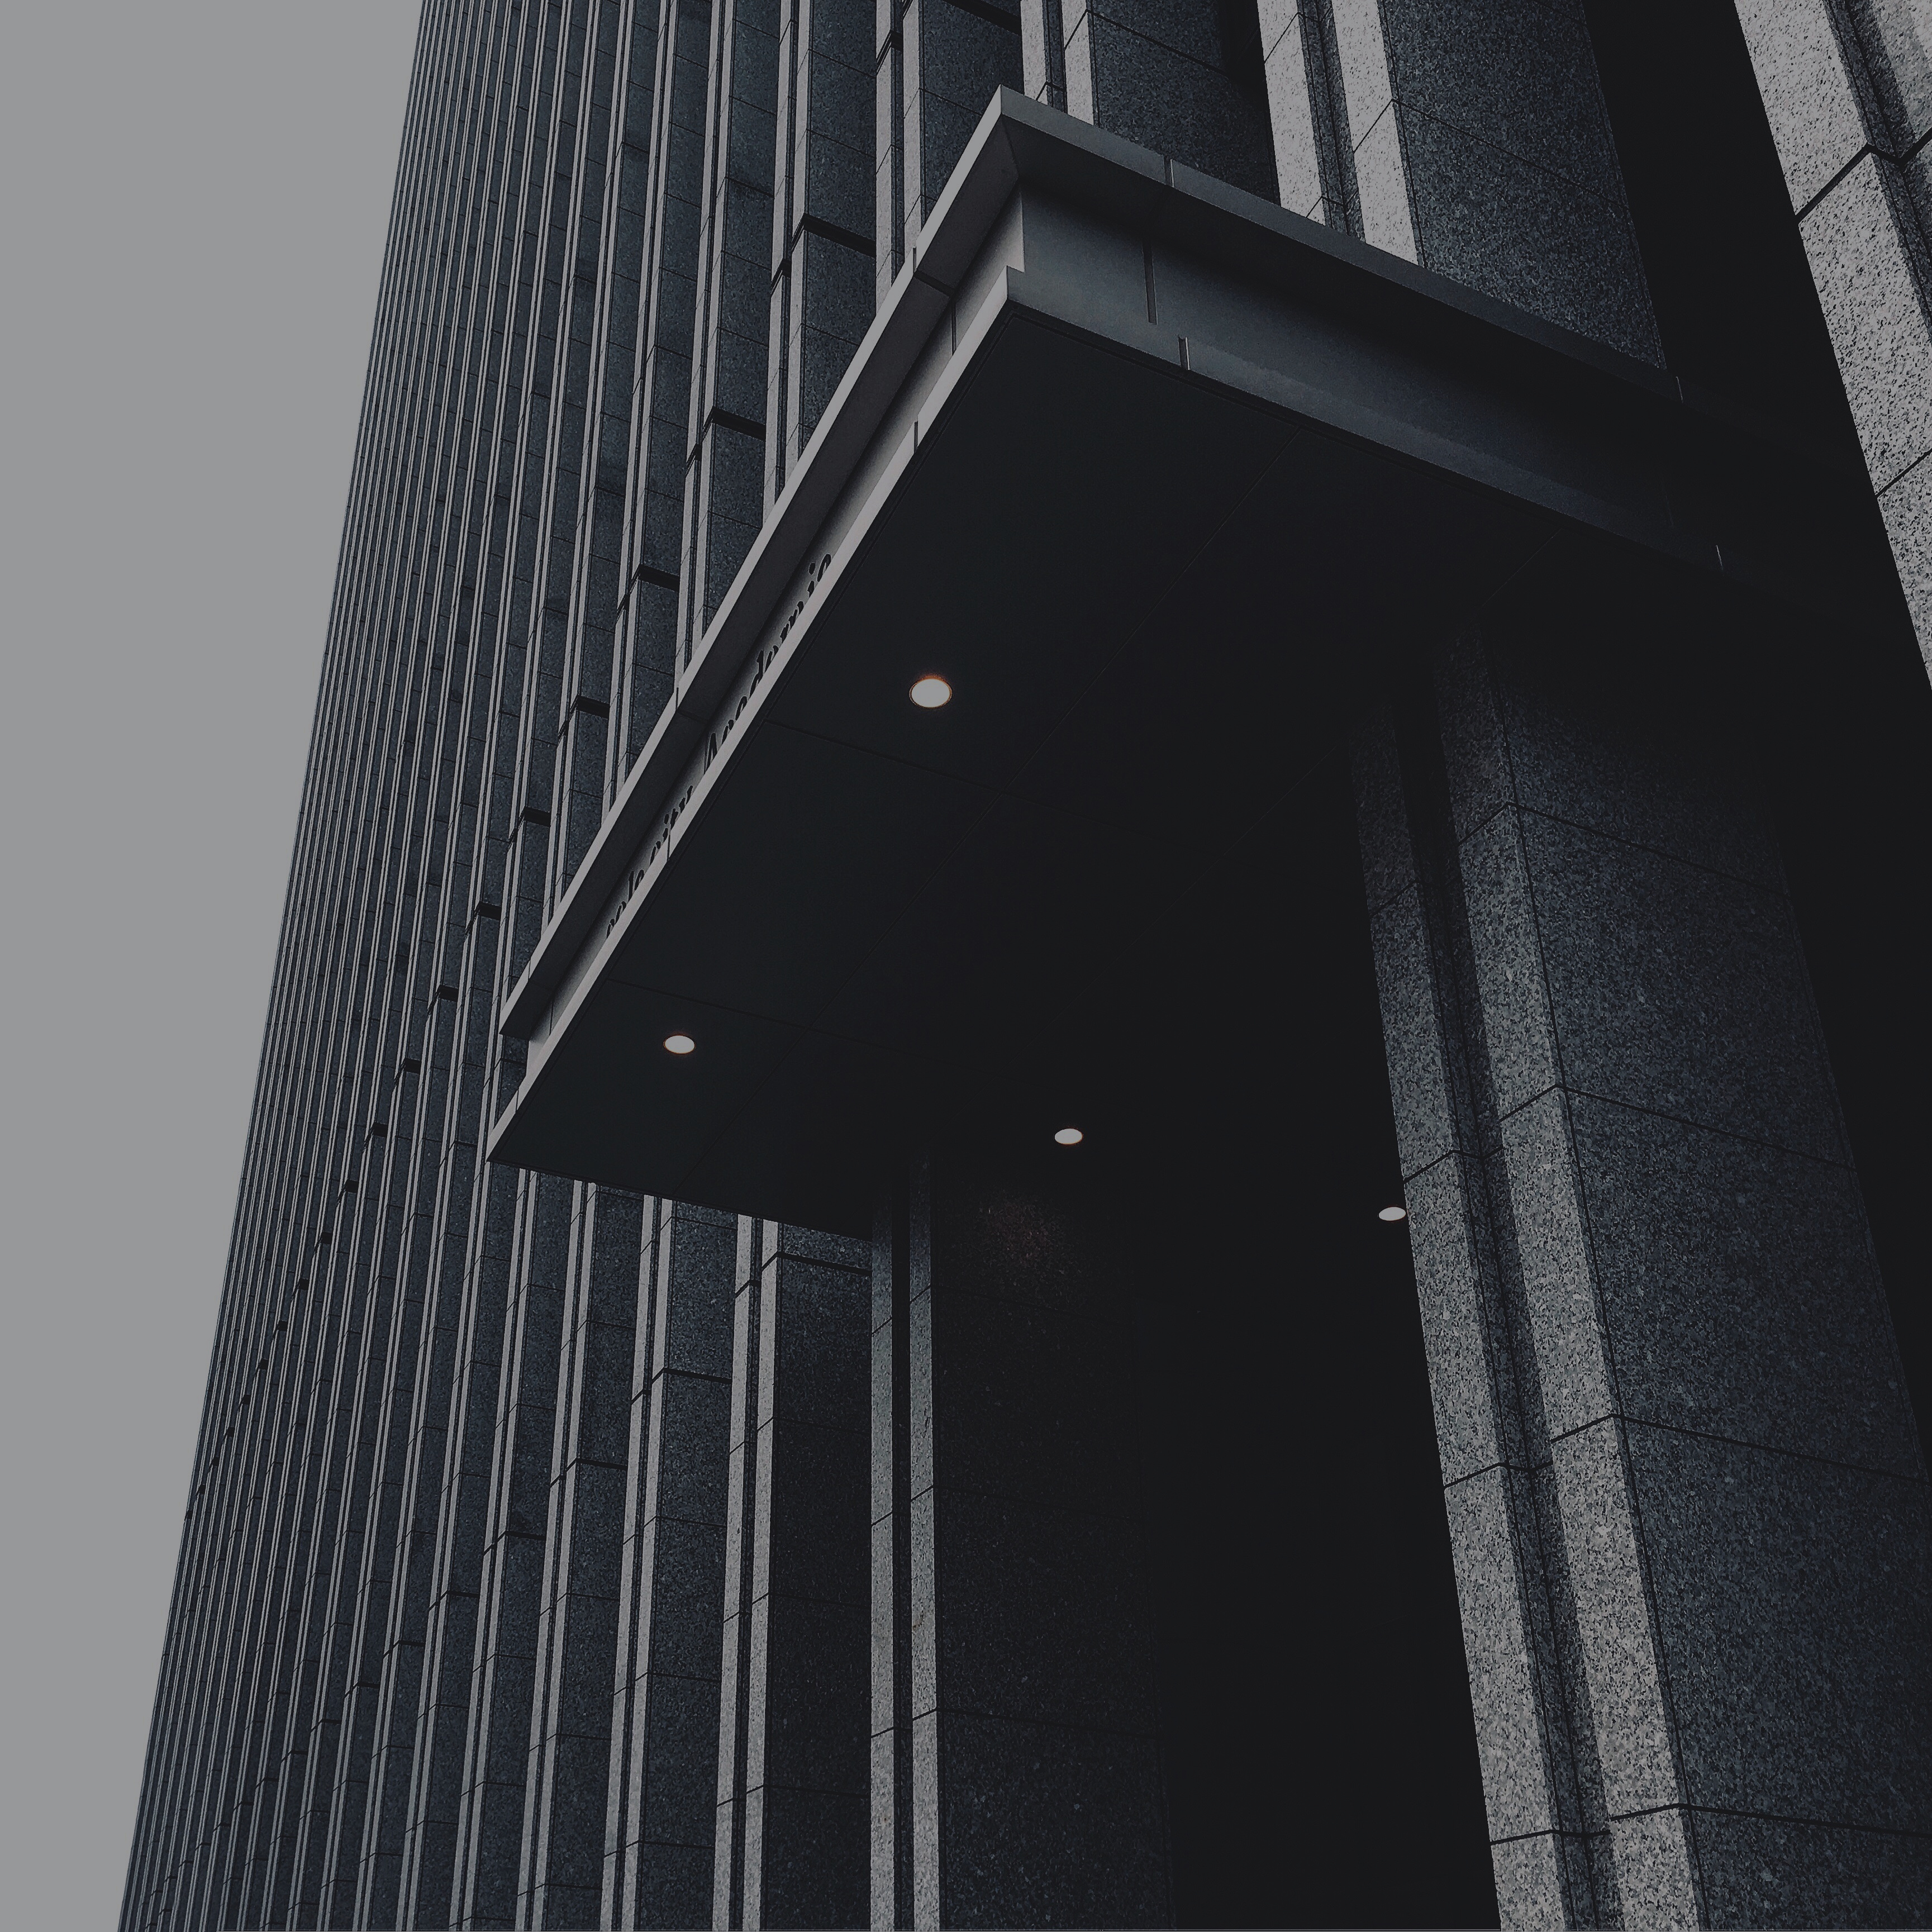
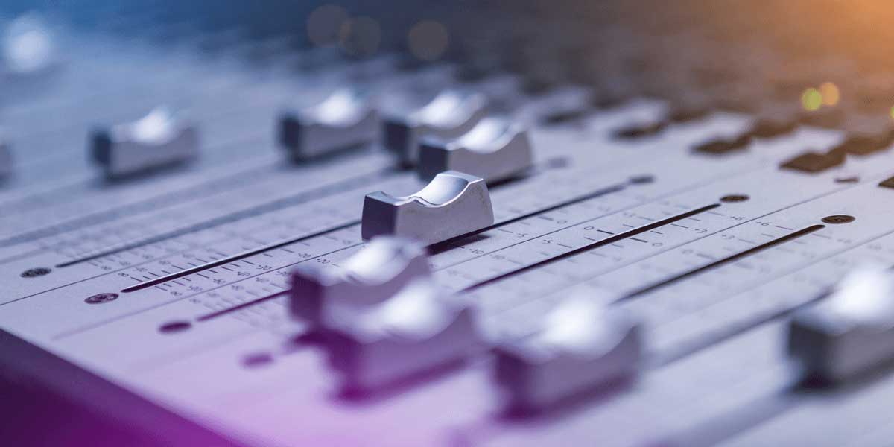

V
December 18, 2024
My Weekly
Updates
Song-Ze, Yu

Slide 2
01
POSSIBILITY OF AI SYNTHESIZERS
Quickly
Rewinds
02
CHANGING THOUGHTS TO DUPLICATE TIMBRE
These are goals I’m working on based
on the goal of making an AI plugin for the year.
03
OPEN TO NEW IDEAS

Slide 3
01
Related Works
02
Content
Architecture
03
What I’ll cover today of things have learned and done these days.
Song-Ze, Yu
Progress

Slide 4
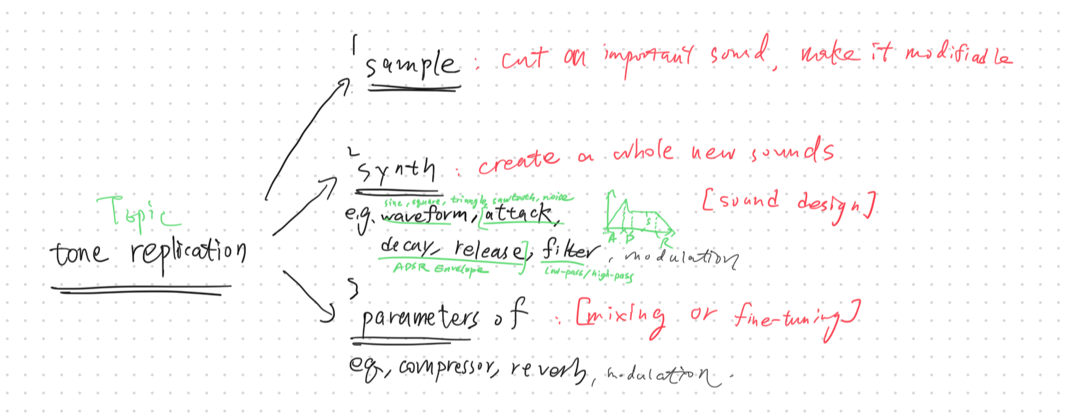
Brief Introduction.

Slide 5
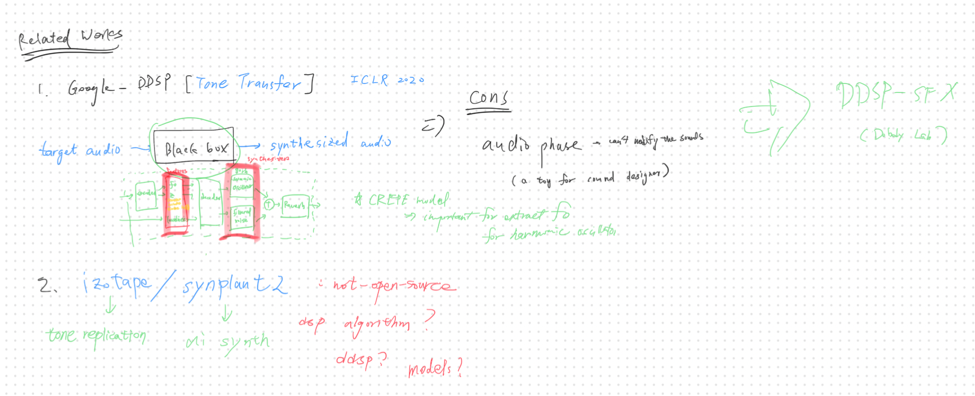
Related Works

Slide 6
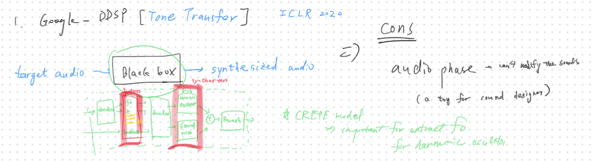

Slide 7
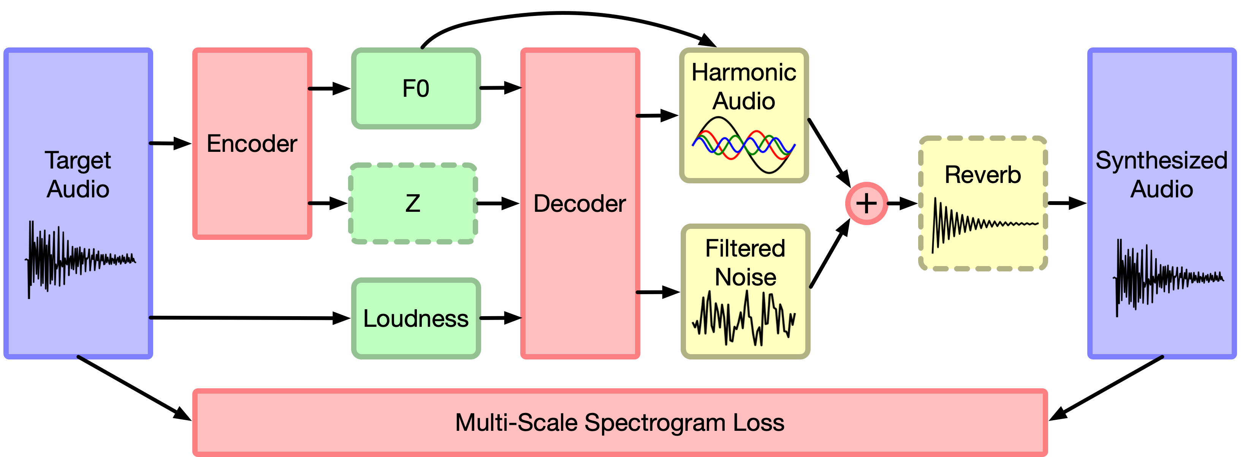

Slide 8
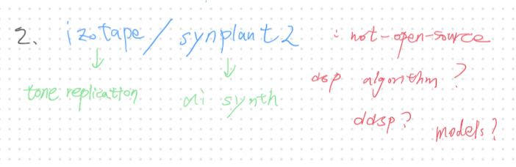
Related Works

Slide 9
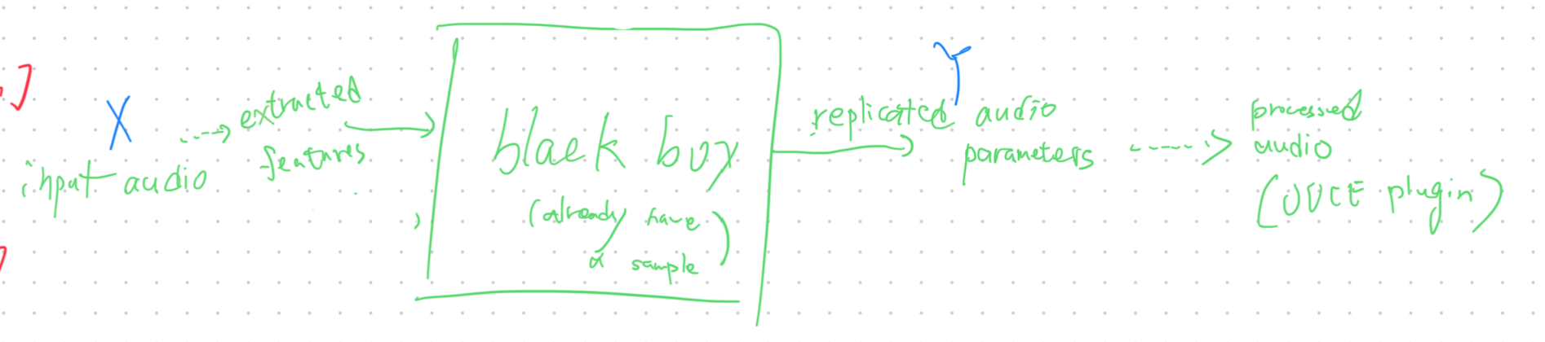
MVP Architecture

Slide 10
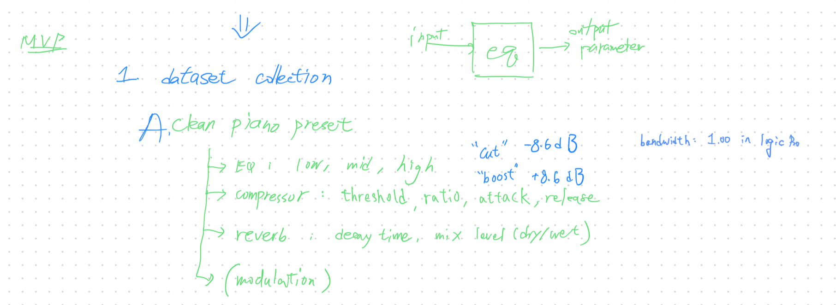
MVP Architecture
Create my own dataset
Goal: 500 samples

Slide 11
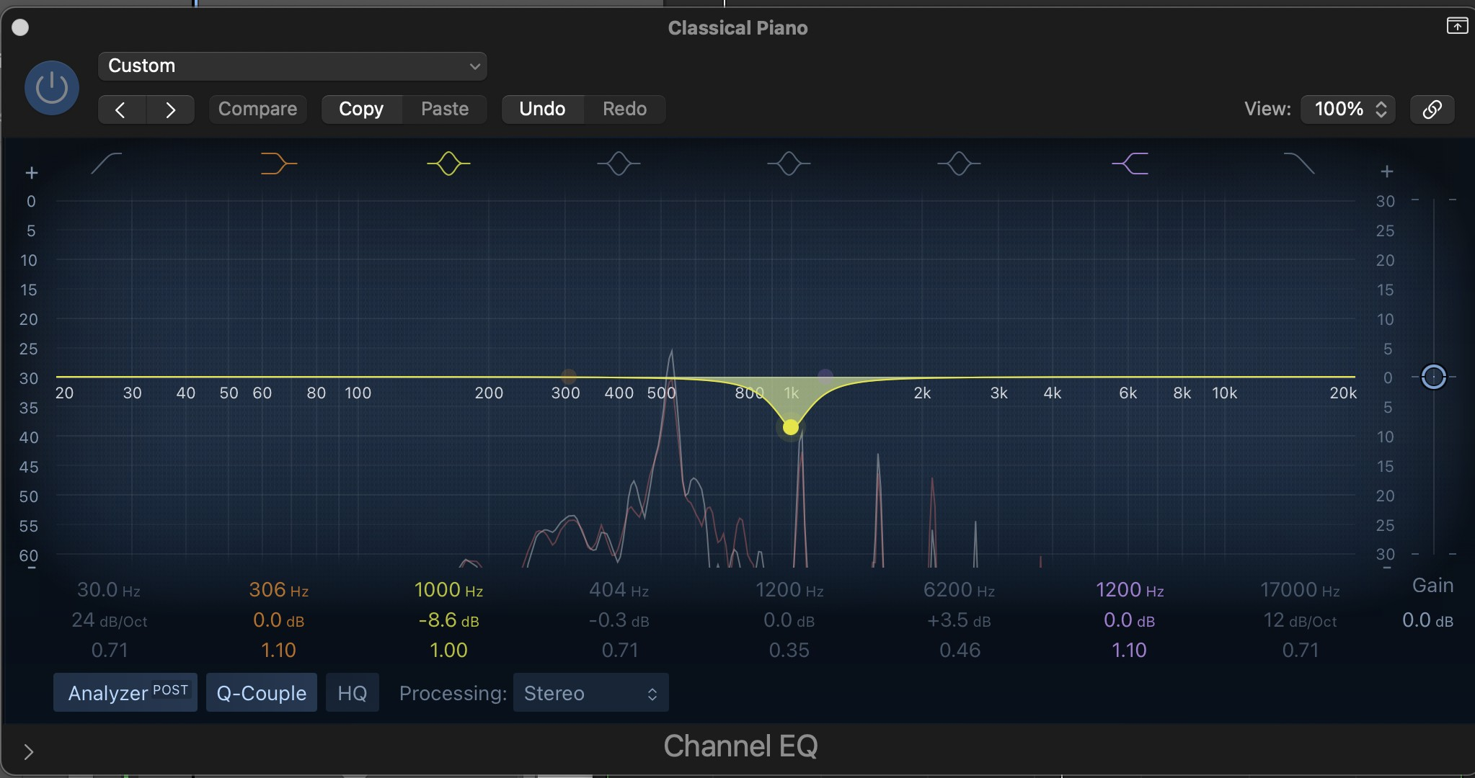
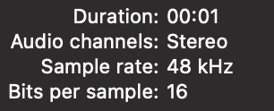

Slide 12
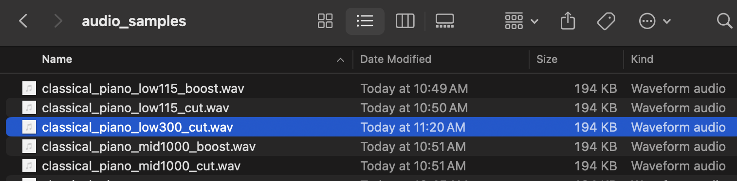

Slide 13
MVP Architecture
Extract Features from Each Sample?
• Spectral Features: Frequency distribution (FFT, MFCCs).
• Dynamic Features: RMS (Root Mean Square) loudness.
• Reverb Indicators: Spectral decay over time.
• Modulation Indicators: Frequency modulation rate.

Slide 14

V
Thank you!
Now, what’s next?

